Slide 1
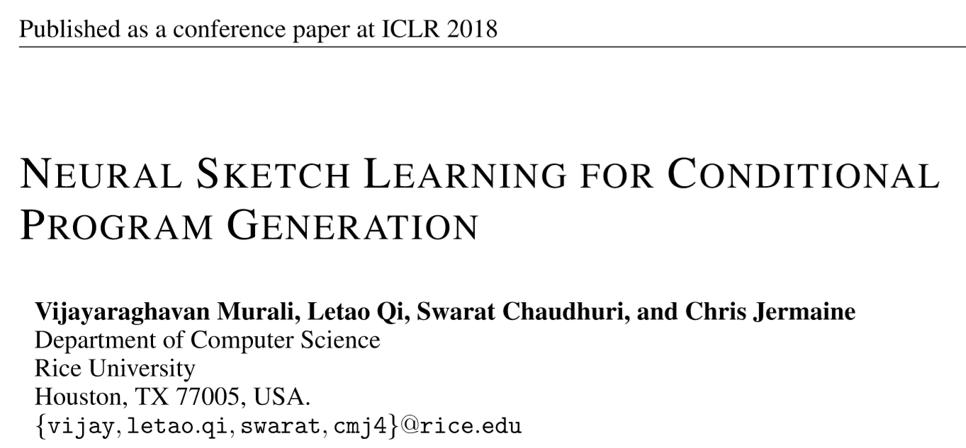
Wasserstein Auto-Encoders
Reporter: Li Qingtao

Slide 2
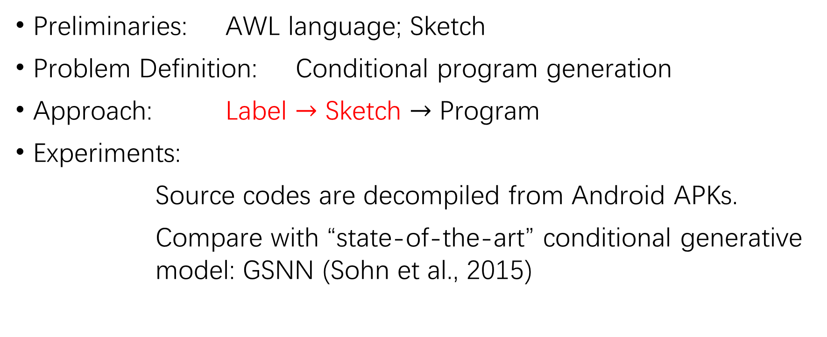
Outline
Preliminaries: AWL language; Sketch
Problem Definition: Conditional program generation
Approach: Label $→$ Sketch $→$ Program
Experiments:
Source codes are decompiled from Android APKs.
Compare with “state-of-the-art” conditional generative model: GSNN (Sohn et al., 2015)

Slide 3
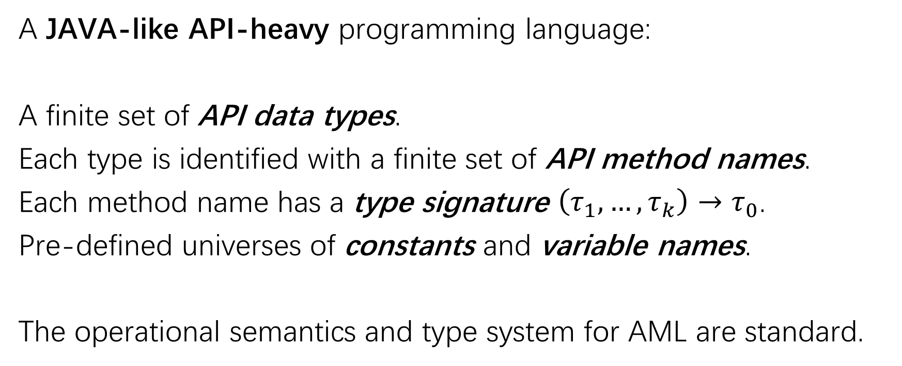
AML Language
A JAVA-like API-heavy programming language:
A finite set of API data types.
Each type is identified with a finite set of API method names.
Each method name has a type signature $\left(τ_{1},…,τ_{k}\right)→τ_{0}$.
Pre-defined universes of constants and variable names.
The operational semantics and type system for AML are standard.

Slide 4
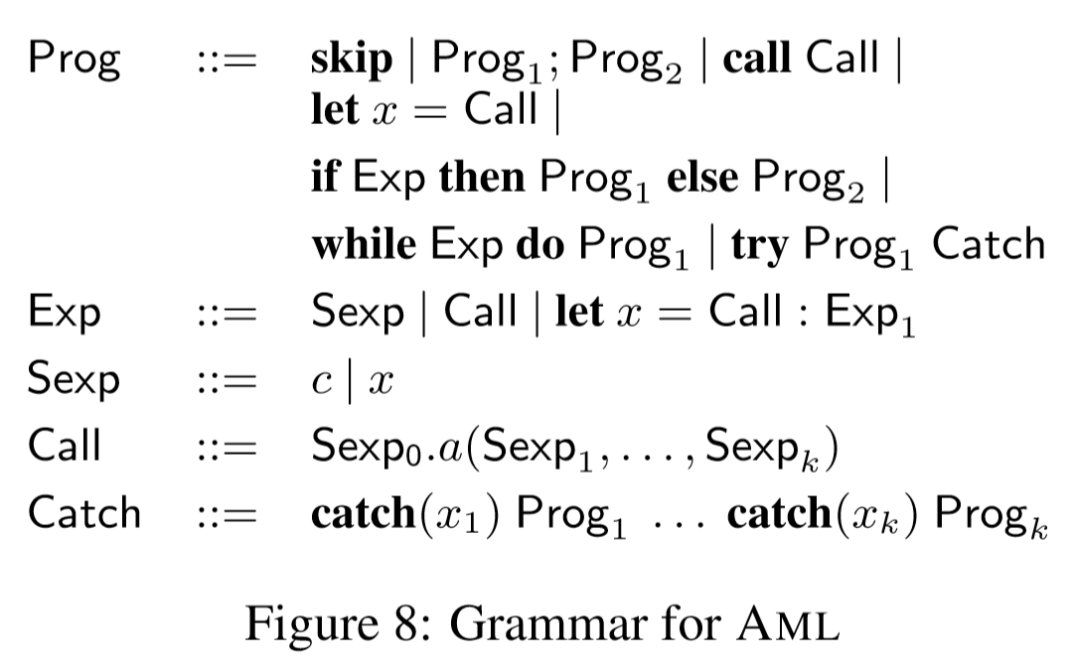
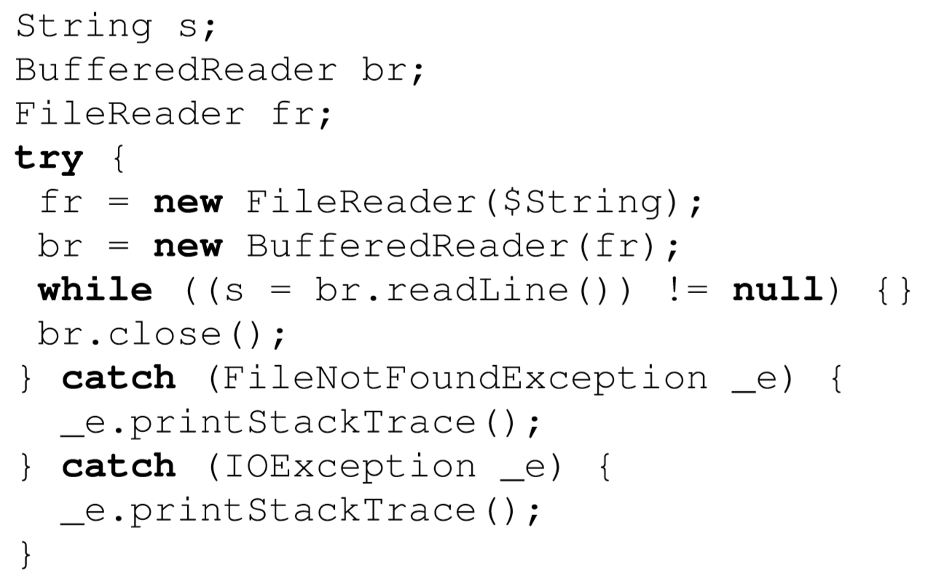
AML Language
An example of AML source code

Slide 5
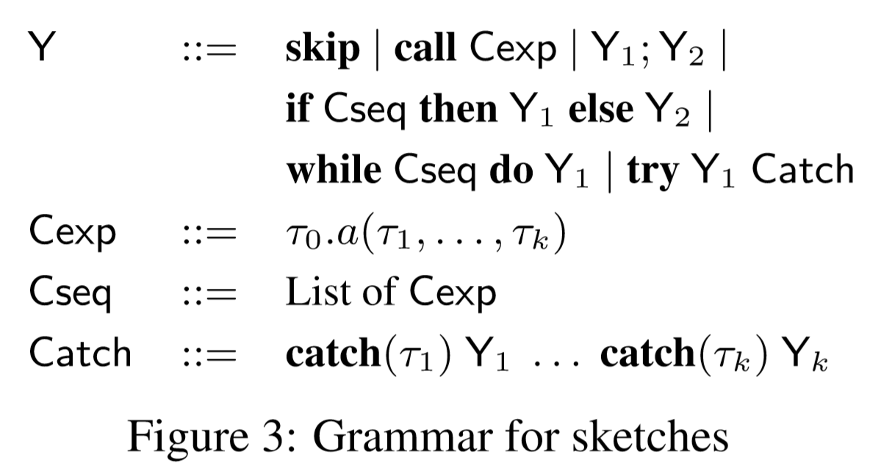
Sketch

Slide 6
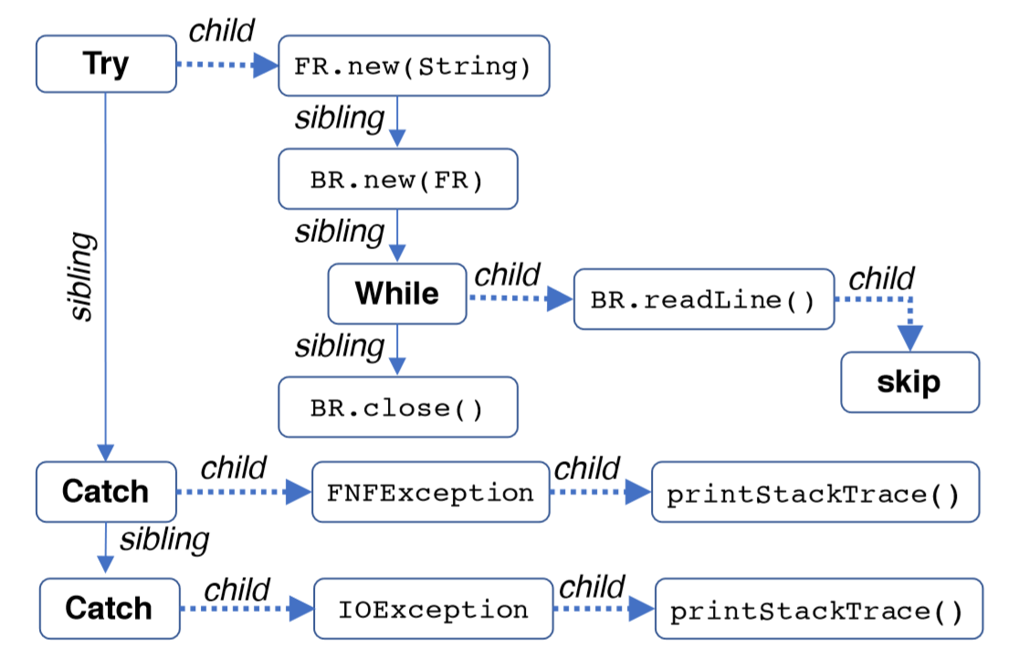
Sketch
Tree-structured

Slide 7
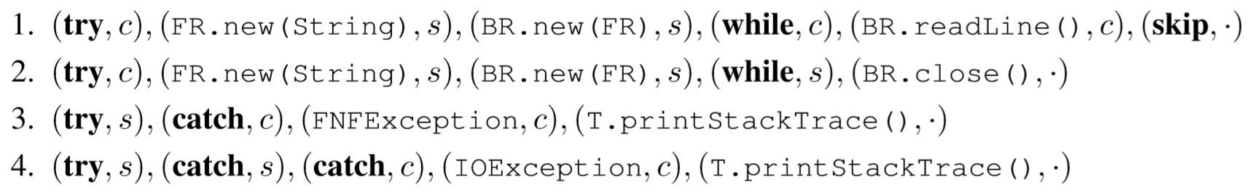
Sketch
“production path”

Slide 8
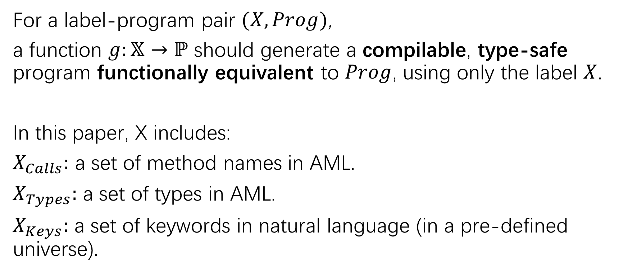
Problem Definition
For a label-program pair $(X, Prog)$,
a function $g:𝕏→ℙ$ should generate a compilable, type-safe program functionally equivalent to $Prog$, using only the label $X$.
In this paper, X includes:
$X_{Calls}:$ a set of method names in AML.
$X_{Types}:$ a set of types in AML.
$X_{Keys}:$ a set of keywords in natural language (in a pre-defined universe).

Slide 9
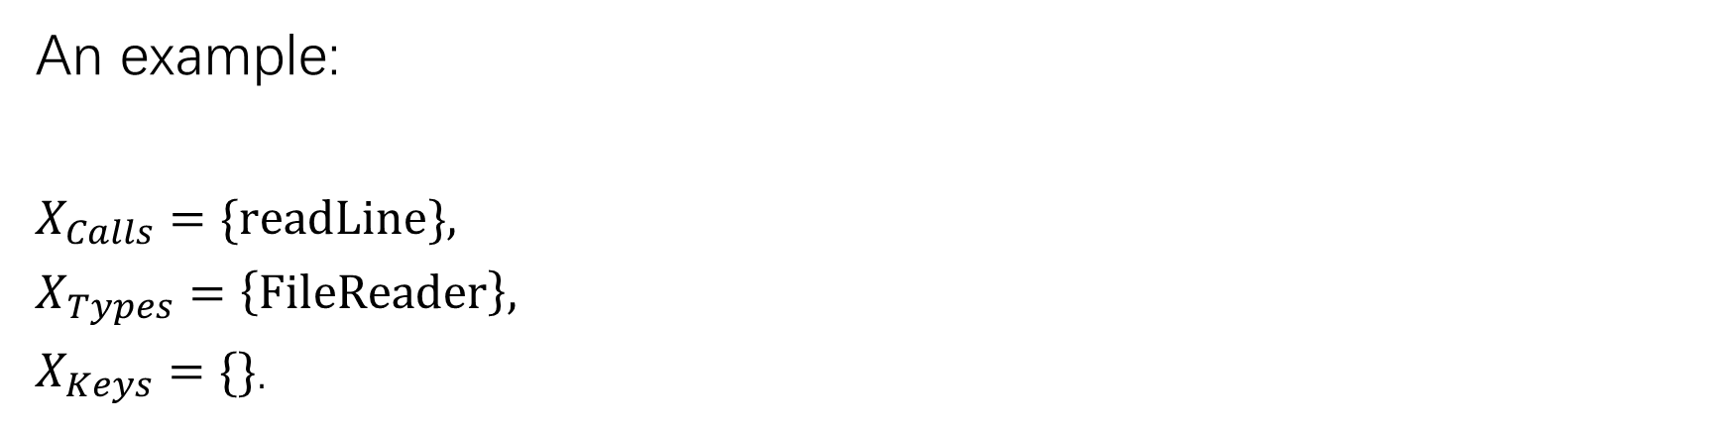
Problem Definition
An example:
$X_{Calls}=\{readLine\}$,
$X_{Types}=\left\{FileReader\right\}$,
$X_{Keys}=\{\}$.
generate

Slide 10
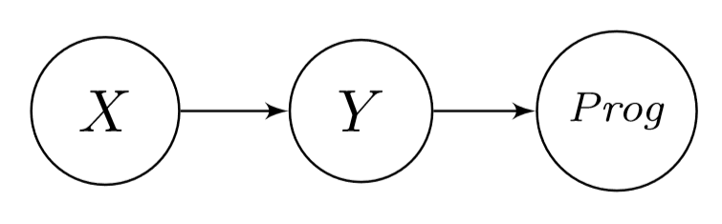

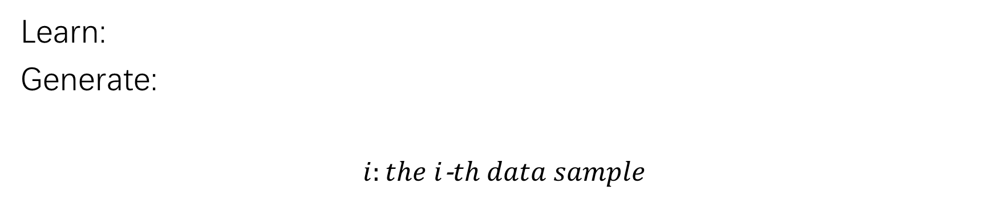
Approach
label
sketch
program
Learn:
Generate:
$i:the i$-$th data sample$

Slide 11
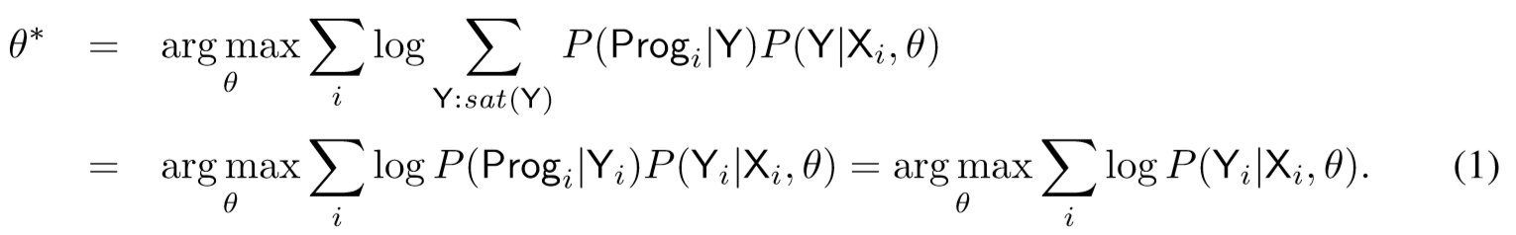
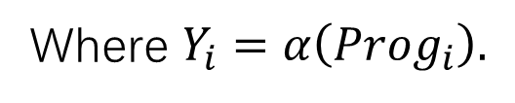
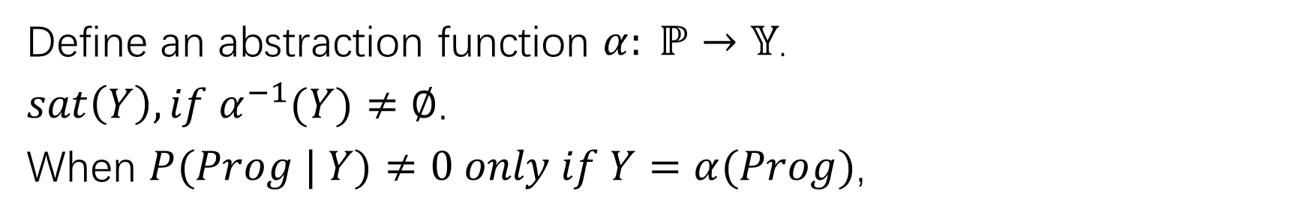
Approach
label
sketch
program
Define an abstraction function $α: ℙ→𝕐$.
$sat\left(Y\right), if α^{−1}(Y)≠∅$.
When $P(Prog | Y)≠0 only if Y=α(Prog)$,
Where $Y_{i}=α\left({Prog}_{i}\right).$
Notes:
Y-Prog的过程是确定性的，因而只需要用某个算法前向计算即可。
训练仅限于X-Y。
We call a sketch Y satisfiable, if $α^{−1}\left(Y\right)≠∅.$

Slide 12
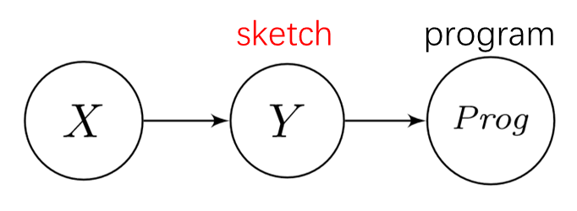
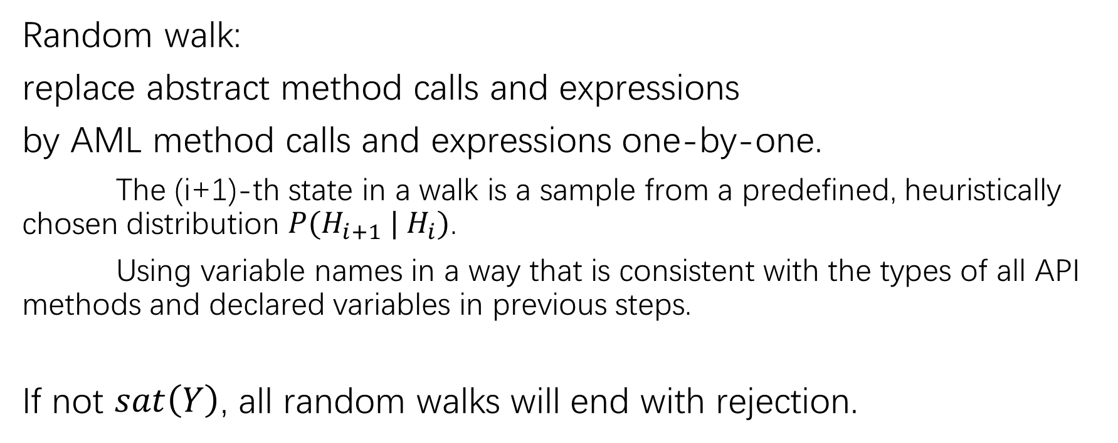
Approach-Combinatorial Concretization
Random walk:
replace abstract method calls and expressions
by AML method calls and expressions one-by-one.
The (i+1)-th state in a walk is a sample from a predefined, heuristically chosen distribution $P(H_{i+1} | H_{i})$.
Using variable names in a way that is consistent with the types of all API methods and declared variables in previous steps.
If not $sat\left(Y\right)$, all random walks will end with rejection.
Notes:
用这种方法倾向于生成较简单的程序

Slide 13
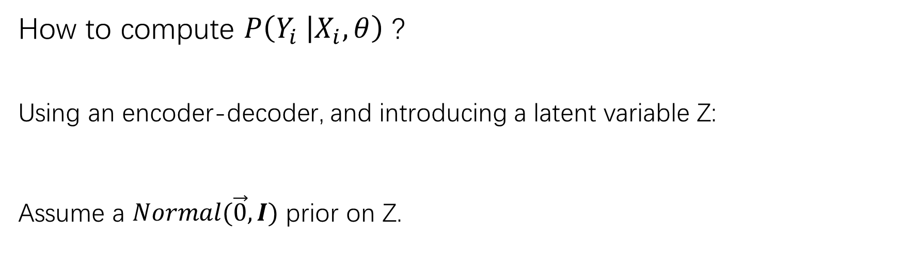
Approach
How to compute $P\left(Y_{i} | X_{i},θ\right)$ ?
Using an encoder-decoder, and introducing a latent variable Z:
Assume a $Normal(\vec{0},I)$ prior on Z.

Slide 14
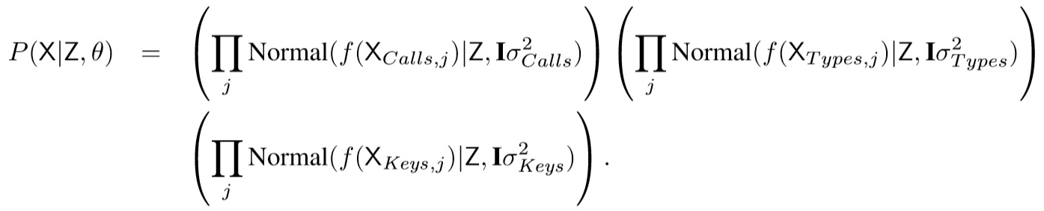
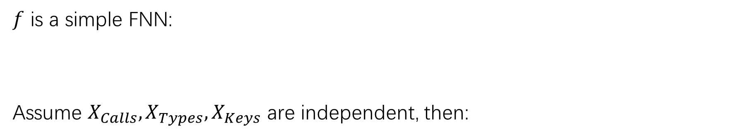
Approach-Gaussian Encoder
$f$ is a simple FNN:
Assume $X_{Calls},X_{Types},X_{Keys}$ are independent, then:

Slide 15

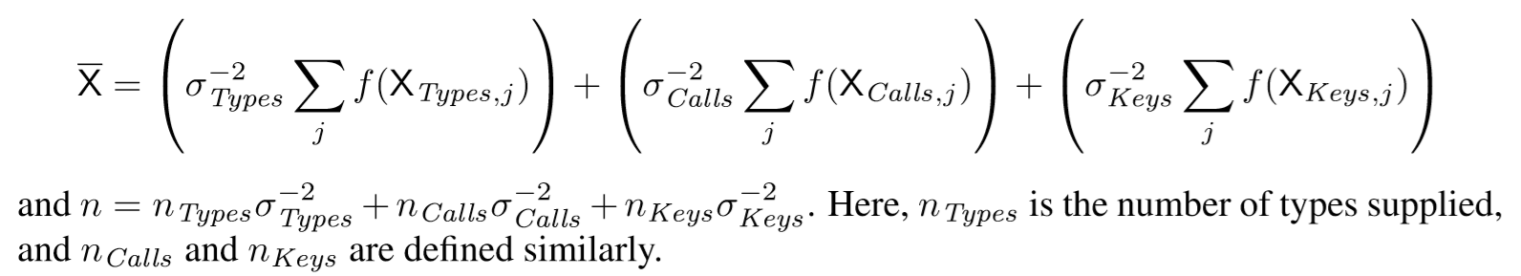
Approach-Gaussian Encoder
Then:
Notes:
含义：f is sampled from a high-dimensional Normal distribution centered at Z
代入正态分布乘法的公式。
Established when f is an 1-1 encoding function. But even if f is not 1-1, it will benefit.

Slide 16



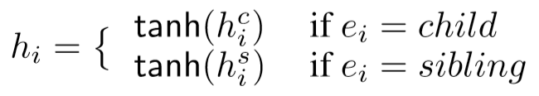
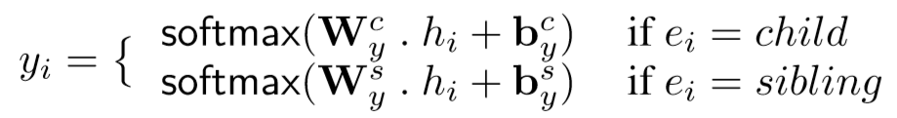
Approach-Decoder
Using a Tree-RNN to generate tree structure:
$v_{i}$ is a node in sketch; $v_{i}^{′}$ is the one-hot encoding of $v_{i}$.

Slide 17
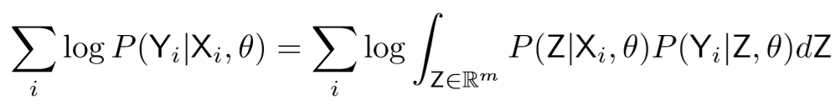
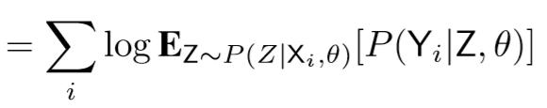
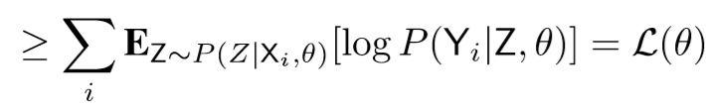
Approach-Optimization

Slide 18
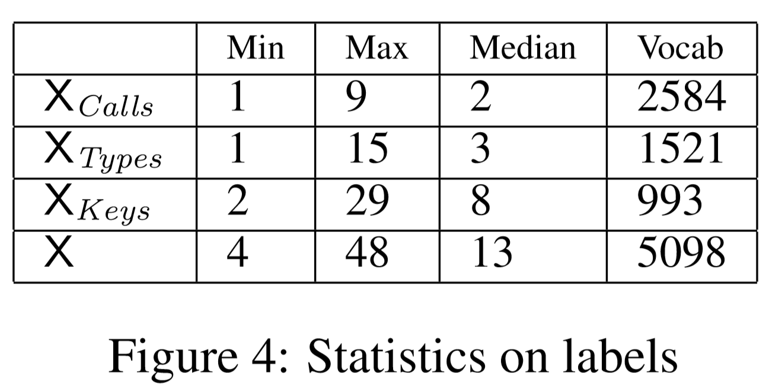
Dataset
data from an online repository of about 1500 Android apps
decompiled the APKs using JADX
extracted 150,000 methods that used Android APIs or the Java library
selected 10,000 methods to be in the testing and validation data each
Notes:
pre-processed all method bodies to translate the code from Java to AML, preserving names of relevant API calls and data types as well as the high-level control flow.

Slide 19
Experiment
Two ways to train:
on production paths in the ASTs
on production paths in the sketches

Slide 20
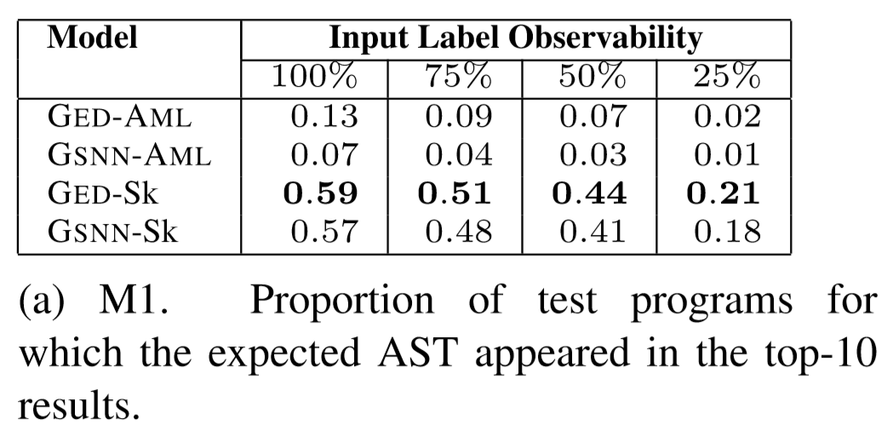
Experiment
M1: whether syntactically equivalent.
abstract away the variable names and compare the rest of the program’s AST.
Notes:
we varied the fraction of the set of API calls, types, and keywords provided as input from the testing data. We experimented with 75%, 50% and 25% observability in the testing data; the median number of items in a label in these cases were 9, 6, and 2, respectively

Slide 21
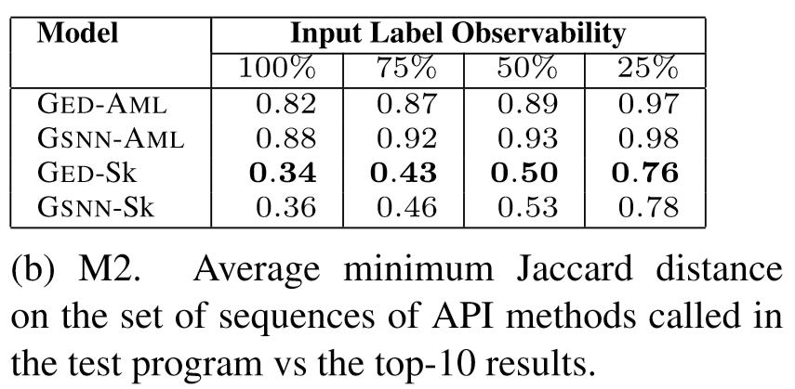
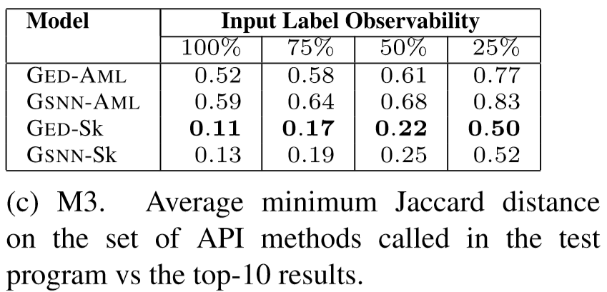
Experiment

Slide 22
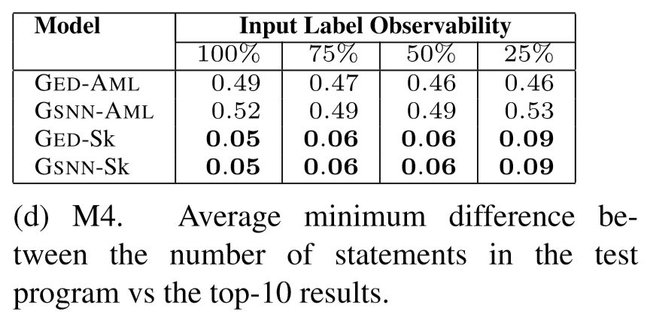
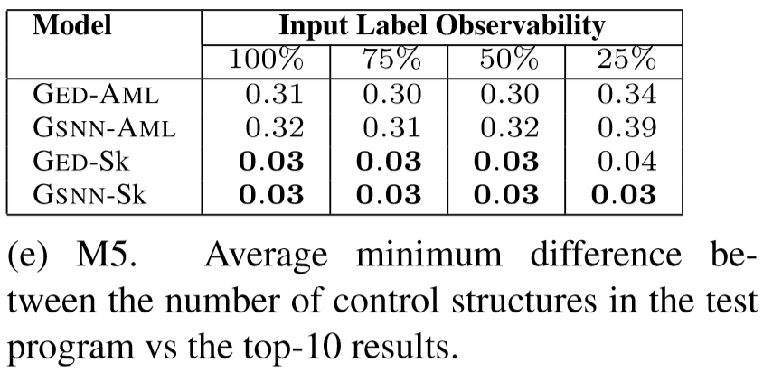
Experiment
ratio: abs(generated-expected)/expected

Slide 23
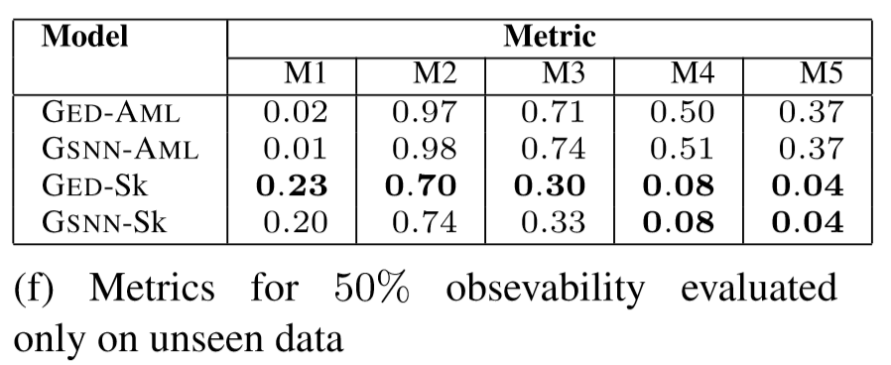
Experiment
In (a)-(e), test data can be seen when training?

Slide 24
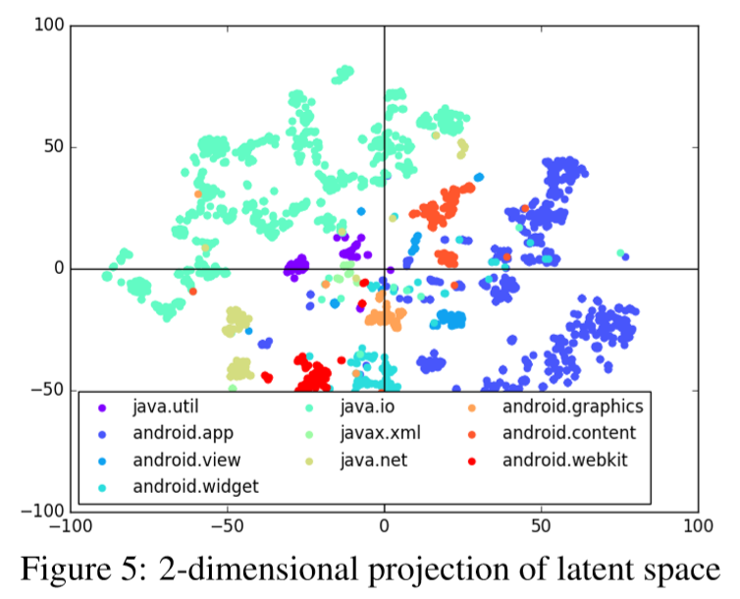
Visualization

Slide 25
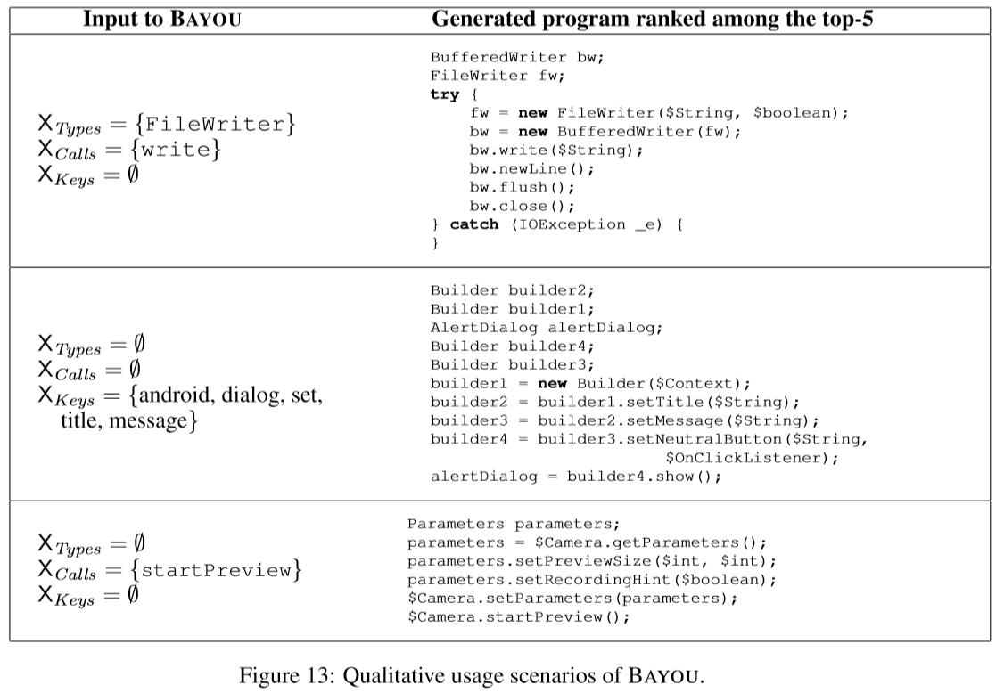
Notes:
feed a BufferedWriter to write to a file
button to the dialog box – another interesting pattern learned from data that dialog boxes in Android often have a button, typically to close the dialog
We confirmed from the Android Camera API documentation that this is recommended practice

Slide 26
Thanks for Listening!
Any Questions?

